Slide 1

Gradient Descent Algorithm and Its Variants

Slide 2
Table of Contents
Optimization
What is a Gradient?
How it works
Learning Rate
How to make sure that it works properly
Types of Gradient Descent (Batch Gradient Descent, Stochastic Gradient Descent, Mini Batch Gradient Descent)
Summary

Slide 3
Optimization
The action of making the best or most effective use of a situation or resource.
Gradient descent is the most popular optimization strategy.
used in machine learning and deep learning at the moment.
It is used while training your model.
It can be combined with every algorithm and is easy to understand and implement.

Slide 4
Optimization
It refers to the task of minimizing an objective function f(x)(cost/loss function) parameterized by x.
In machine/deep learning terminology, it’s the task of minimizing the cost/loss function J(w) parameterized by the model’s parameters
Optimization algorithms (in case of minimization) have one of the following goals:
Find the global minimum of the objective function. This is feasible if the objective function is convex, i.e. any local minimum is a global minimum.
Find the lowest possible value of the objective function within its neighborhood. That’s usually the case if the objective function is not convex as the case in most deep learning problems.

Slide 5
The gradient descent algorithm seeks to change the weights so that the next evaluation reduces the error, meaning the optimization algorithm is navigating down the gradient (or slope) of error.
Gradient descent is an optimization algorithm used to minimize some function by iteratively moving in the direction of steepest descent

Slide 6
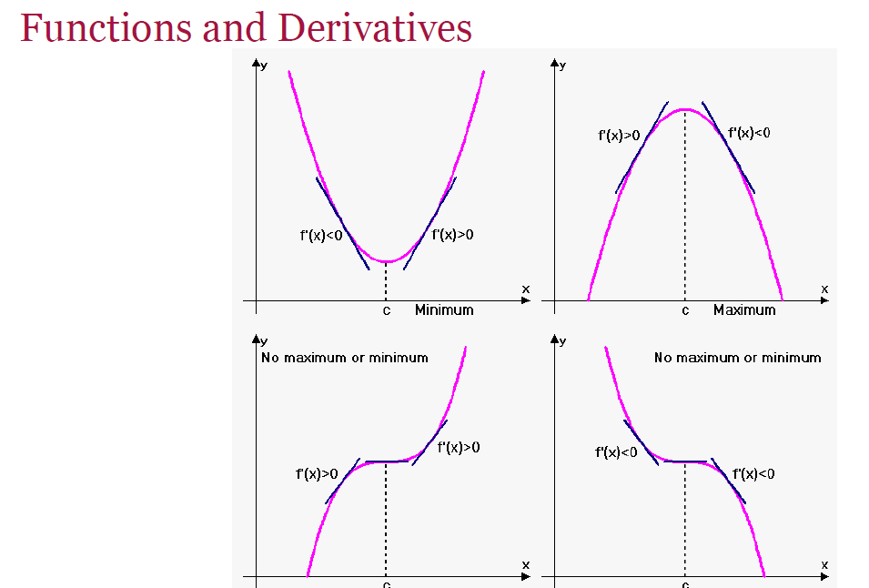
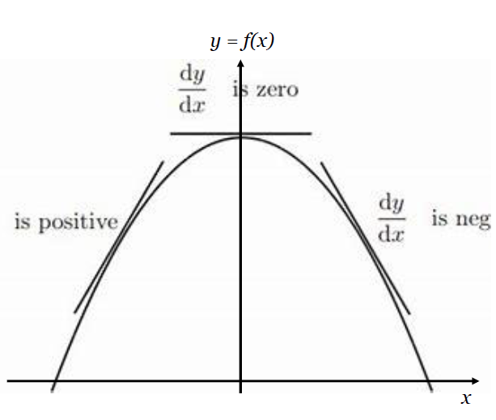

Slide 7
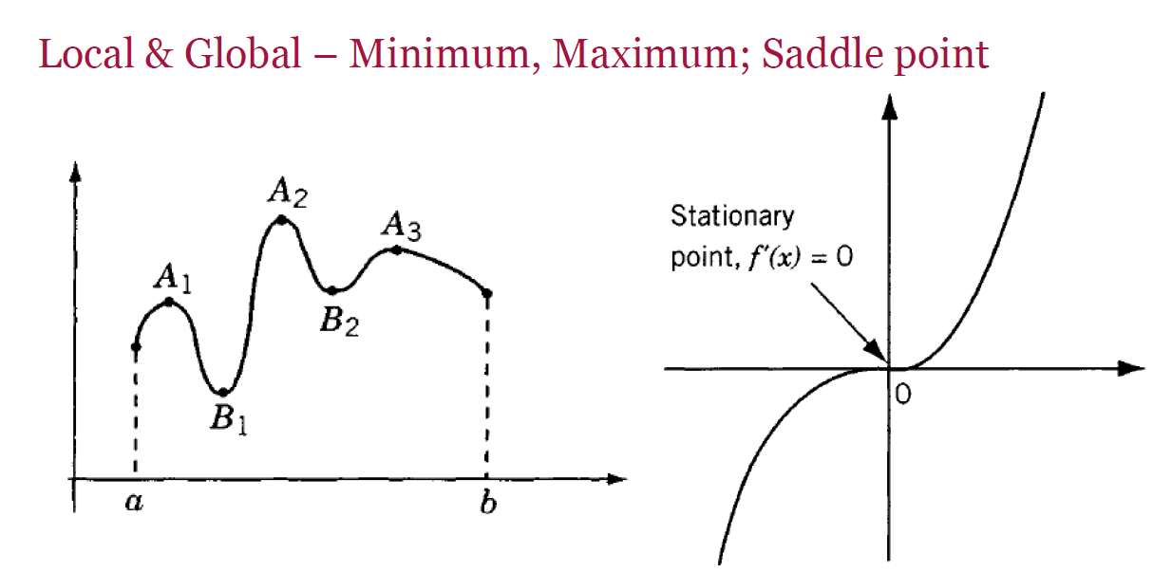

Slide 8
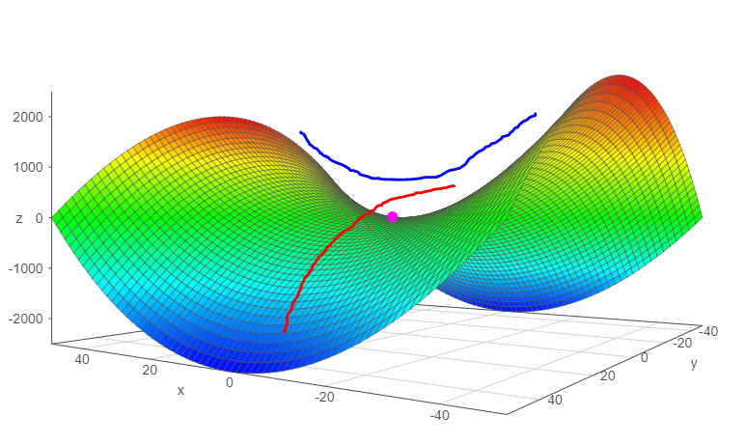
Saddle point is when the function curves up in some directions and curves down in other directions.
a saddle point or minimax point is a point on the surface of the graph of a function where the slopes (derivatives) in orthogonal directions are all zero
In other words, saddle point looks like a minimum from one direction and a maximum from other direction

Slide 9
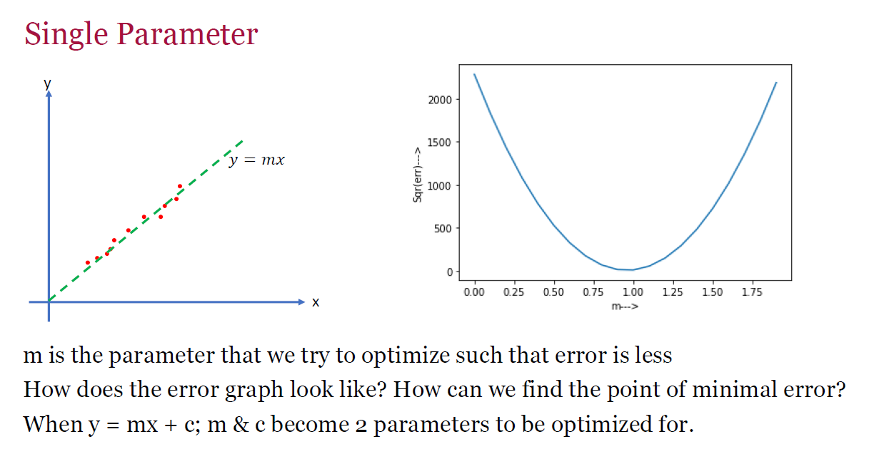

Slide 10
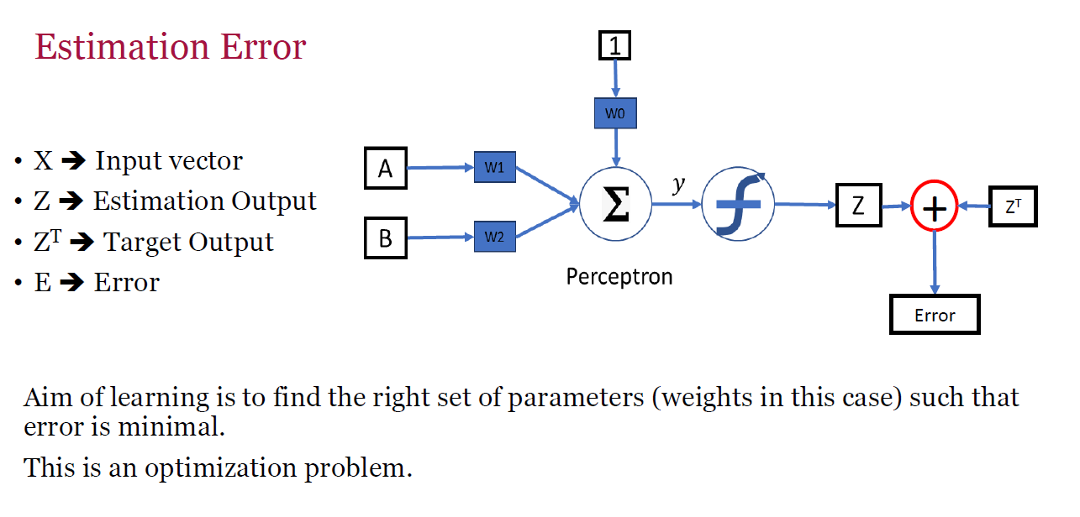

Slide 11
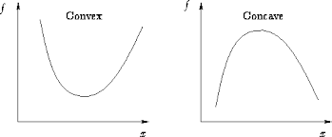
A concave function: no line segment joining two points on the graph lies above the graph at any point A .
convex function: no line segment joining two points on the graph lies below the graph at any point
Notes:
We wont get any line down to graph

Slide 12
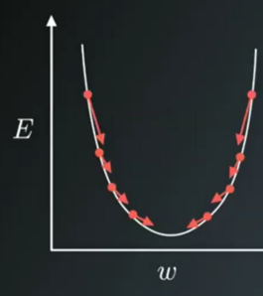
Gradient provides direction. In Machine Learning, we are basically trying to reach an optimal solution (bottom of the bowl).
Gradient is simply a vector which gives the direction of maximum rate of change. By taking steps in that direction, we hope to reach our optimal solution.
It tells which direction it should step to reduce the loss most quickly
-ve gradient tells , it should step down
+ve gradient tells, it should step up
The length of gradient vector indicates how steep is the slop

Slide 13
Optimization
Optimization algorithms helps us to minimize (or maximize) an Objective function (another name for Error function) E(x) which is simply a mathematical function dependent on the Model’s internal learnable parameters which are used in computing the target values(Y) from the set of predictors(X) used in the model.
For example — we call the Weights(W) and the Bias(b) values of the neural network as its internal learnable parameters which are used in computing the output values and are learned and updated in the direction of optimal solution i.e minimizing the Loss by the network’s training process and also play a major role in the training process of the Neural Network Model .

Slide 14
Gradient Descent
Gradient descent is by far the most popular optimization strategy, used in machine learning and deep learning at the moment.
It is used while training your model, can be combined with every algorithm and is easy to understand and implement.
Therefore, everyone who works with Machine Learning should understand it’s concept.

Slide 15
Gradient Descent
It is the most popular Optimization algorithms used in optimizing a Neural Network.
Now gradient descent is majorly used to do Weights updates in a Neural Network Model , i.e update and tune the Model’s parameters in a direction so that we can minimize the Loss function.
In Backpropagation, we first propagate forward calculating the dot product of Inputs signals and their corresponding Weights and then apply a activation function to those sum of products, which transforms the input signal to an output signal and also is important to model complex Non-linear functions and introduces Non-linearities to the Model which enables the Model to learn almost any arbitrary functional mappings.
In gradient descent, we calculate the derivative of the activation function because the derivative helps us understand how the activation function's output changes with respect to its input. This information is crucial for updating the weights during backpropagation in neural networks

Slide 16
Gradient Descent
Gradient Descent is used while training a machine learning model. It is an optimization algorithm, based on a convex function, that tweaks it’s parameters iteratively to minimize a given function to its local minimum.
It is simply used to find the values of a functions parameters (coefficients) that minimize a cost function as far as possible.
You start by defining the initial parameters values and from there on Gradient Descent iteratively adjusts the values, using calculus, so that they minimize the given cost-function.

Slide 17
Gradient Descent
It is the most common optimization algorithm in machine learning and deep learning.
It is a first-order optimization algorithm. This means it only takes into account the first derivative when performing the updates on the parameters.
On each iteration, we update the parameters in the opposite direction of the gradient of the objective function J(w) w.r.t the parameters where the gradient gives the direction of the steepest ascent.
The size of the step we take on each iteration to reach the local minimum is determined by the learning rate α. Therefore, we follow the direction of the slope downhill until we reach a local minimum.

Slide 18
What is a Gradient?
“A gradient measures how much the output of a function changes if you change the inputs a little bit.” — Lex Fridman (MIT)
It simply measures the change in all weights with regard to the change in error.
You can also think of a gradient as the slope of a function.
The higher the gradient, the steeper the slope and the faster a model can learn. But if the slope is zero, the model stops learning.
Said it more mathematically, a gradient is a partial derivative with respect to its inputs.

Slide 19
Imagine a blindfolded man who wants to climb a hill, with the fewest steps possible. He just starts climbing the hill by taking really big steps in the steepest direction, which he can do, as long as he is not close to the top. As he comes further to the top, he will do smaller and smaller steps, since he doesn’t want to overshoot it. This process can be described mathematically, using the gradient.

Slide 20
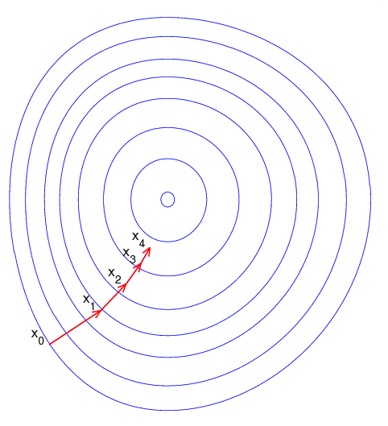
Imagine it illustrates our hill from a top-down view, where the red arrows show the steps of our climber. Think of a gradient in this context as a vector that contains the direction of the steepest step the blindfolded man can go and also how long this step should be.
Note that the gradient ranging from X0 to X1 is much longer than the one reaching from X3 to X4. This is because the steepness/slope of the hill is less there, which determines the length of the vector. This perfectly represents the example of the hill, because the hill is getting less steep, the higher you climb it. Therefore a reduced gradient goes along with a reduced slope and a reduced step-size for the hill climber.

Slide 21
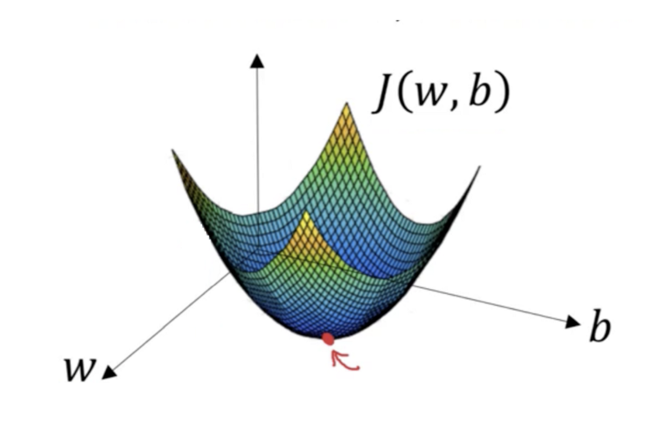
How it works
Imagine you are dealing with a machine learning problem and want to train your algorithm with gradient descent to minimize your cost-function J(w, b) and reach its local minimum by tweaking its parameters (w and b).
we want to find the values of w and b that correspond to the minimum of the cost function (marked with the red arrow). To start with finding the right values we initialize the values of w and b with some random numbers and Gradient Descent then starts at that point (somewhere around the top of our illustration). Then it takes one step after another in the steepest downside direction (e.g. from the top to the bottom of the illustration) till it reaches the point where the cost function is as small as possible.

Slide 22
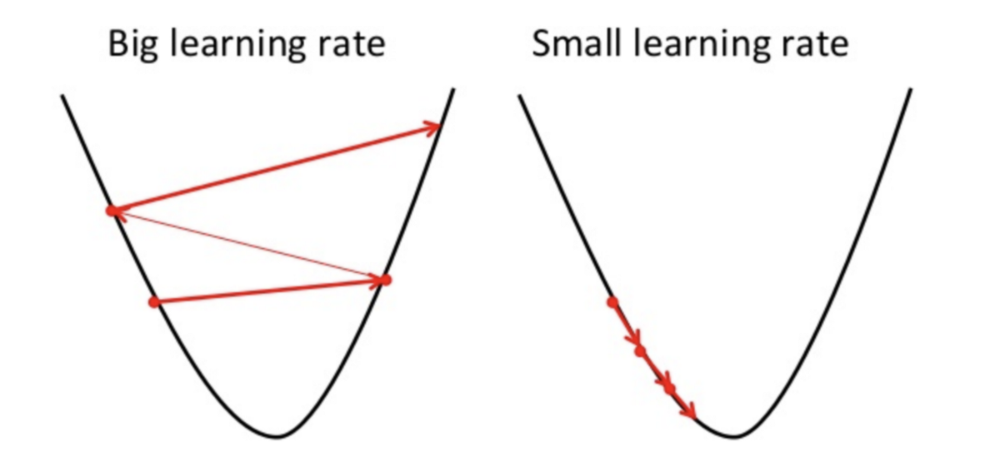
Importance of the Learning Rate
How big the steps are that Gradient Descent takes into the direction of the local minimum are determined by the so-called learning rate. It determines how fast or slow we will move towards the optimal weights.
In order for Gradient Descent to reach the local minimum, we have to set the learning rate to an appropriate value, which is neither too low nor too high.
This is because if the steps it takes are too big, it maybe will not reach the local minimum because it just bounces back and forth between the convex function of gradient descent like you can see on the left side of the image below. If you set the learning rate to a very small value, gradient descent will eventually reach the local minimum but it will maybe take too much time like you can see on the right side of the image.
This is the reason why the learning rate should be neither too high nor too low. You can check if you’re learning rate is doing well by plotting the learning rate on a graph

Slide 23
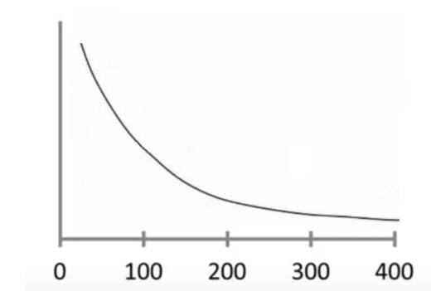
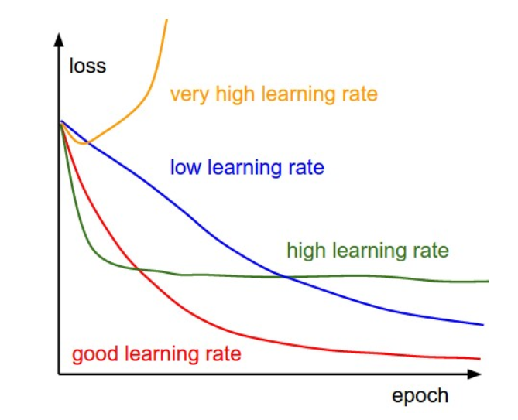
How to make sure that it works properly
A good way to make sure that Gradient Descent runs properly is by plotting the cost function as Gradient Descent runs. You put the number of iterations on the x-axes and the value of the cost-function at the y-axes. This enables you to see the value of your cost function after each iteration of gradient descent. This lets you easily spot how appropriate your learning rate is.
You can see such a plot below on the left and the image on the right shows the difference between good and bad learning rates: If gradient descent is working properly, the cost function should decrease after every iteration.

Slide 24
When Gradient Descent can’t decrease the cost-function anymore and remains more or less on the same level, we say it has converged.
Note that the number of iterations that Gradient Descent needs to converge can sometimes vary a lot.
It can take 50 iterations, 60,000 or maybe even 3 million. Therefore the number of iterations is hard to estimate in advance.
Out there are also some algorithms that can tell you automatically if Gradient Descent has converged but you need to define a threshold for the convergence beforehand which is also pretty hard to estimate.
This is why these simple plots are the preferred convergence test.
Another advantage of monitoring Gradient Descent via plots is that you can easily spot if it doesn’t work properly, like for example if the cost function is increasing.
Mostly the reason for an increasing cost-function, while using Gradient Descent, is that you’re learning rate is too high.
If you see in the plot that your learning curve is just going up and down, without really reaching a lower point, you also should try to decrease the learning rate.
The most commonly used rates are : 0.001, 0.003, 0.01, 0.03, 0.1, 0.3.

Slide 25
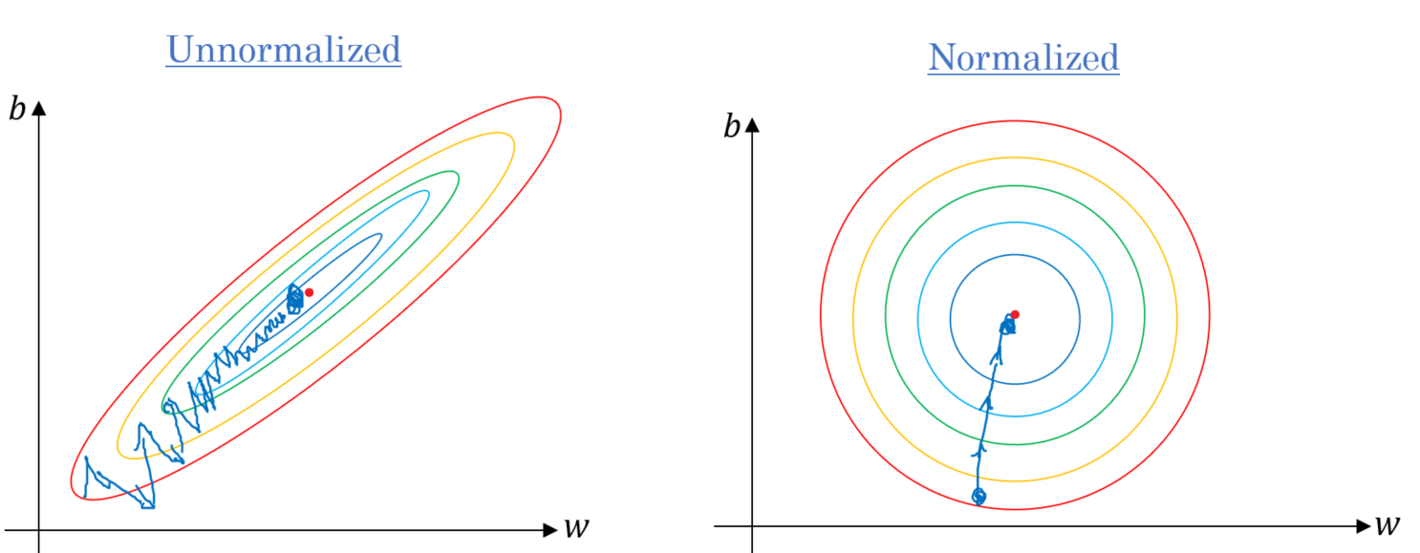
Make sure to scale the data if it’s on a very different scales. If we don’t scale the data, the level curves (contours) would be narrower and taller which means it would take longer time to converge

Slide 26
Normalization:
The goal of normalization is to change the values of numeric columns in the dataset to a common scale, without distorting differences in the ranges of values. For machine learning, every dataset does not require normalization. It is required only when features have different ranges.

Slide 27
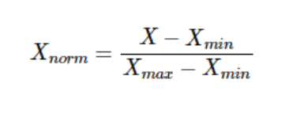
For example, consider a data set containing two features, age, and income(x2). Where age ranges from 0–100, while income ranges from 0–100,000 and higher. Income is about 1,000 times larger than age. So, these two features are in very different ranges. When we do further analysis, like multivariate linear regression, for example, the attributed income will intrinsically influence the result more due to its larger value. But this doesn’t necessarily mean it is more important as a predictor. So we normalize the data to bring all the variables to the same range.

Slide 28
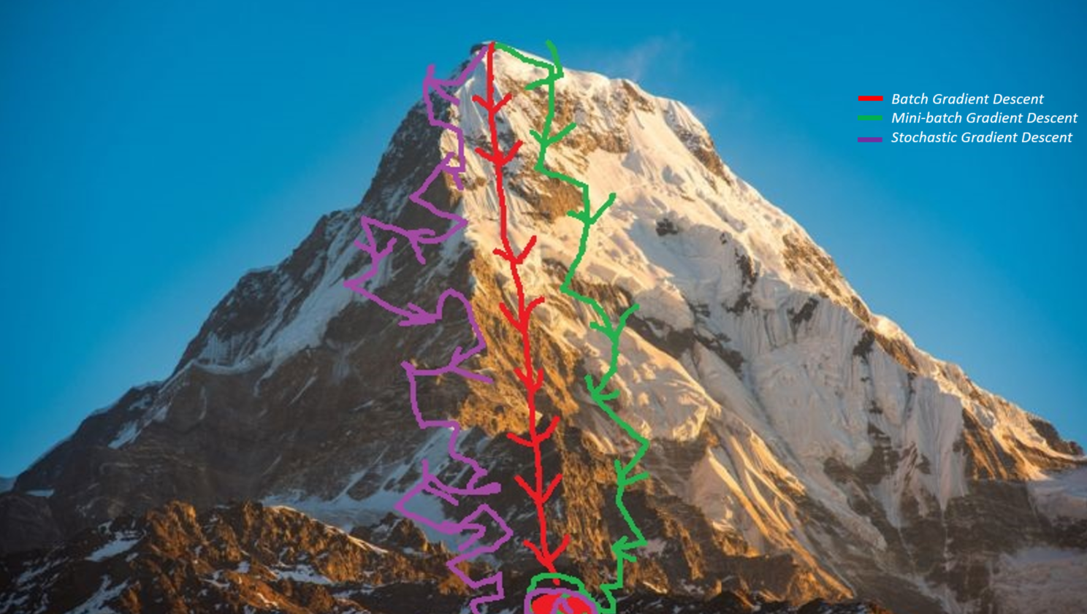
Types of Gradient Descent
Batch Gradient Descent
Mini-batch Gradient Descent
Stochastic Gradient Descent
The main difference between them is the amount of data we use when computing the gradients for each learning step.
The trade-off between them is the accuracy of the gradient versus the time complexity to perform each parameter’s update (learning step).

Slide 29
Batch Gradient Descent
Batch Gradient Descent, also called vanilla gradient descent, calculates the error for each example within the training dataset, but only after all training examples have been evaluated, the model gets updated.
This whole process is like a cycle and called a training epoch.

Slide 30
Batch Gradient Descent
The main advantages:
We can use fixed learning rate during training without worrying about learning rate decay.
It has straight trajectory towards the minimum and it is guaranteed to converge in theory to the global minimum if the loss function is convex and to a local minimum if the loss function is not convex.
It has unbiased estimate of gradients. The more the examples, the lower the standard error.
That it’s computational efficient, it produces a stable error gradient and a stable convergence.
The main disadvantages:
Even though we can use vectorized implementation, it may still be slow to go over all examples especially when we have large datasets.
Each step of learning happens after going over all examples where some examples may be redundant and don’t contribute much to the update.
stable error gradient can sometimes result in a state of convergence that isn’t the best the model can achieve. It also requires that the entire training dataset is in memory and available to the algorithm.

Slide 31
Stochastic Gradient Descent
Stochastic Gradient Descent (SGD) in contrary, does this for each training example within the dataset. This means that it updates the parameters for each training example, one by one. This can make SGD faster than Batch Gradient Descent, depending on the problem. One advantage is that the frequent updates allow us to have a pretty detailed rate of improvement.
The thing is that the frequent updates are more computationally expensive as the approach of Batch Gradient Descent.
The frequency of those updates can also result in noisy gradients, which may cause the error rate to jump around, instead of slowly decreasing.
Shuffle the training data set to avoid pre-existing order of examples.
Partition the training data set into m examples.

Slide 32
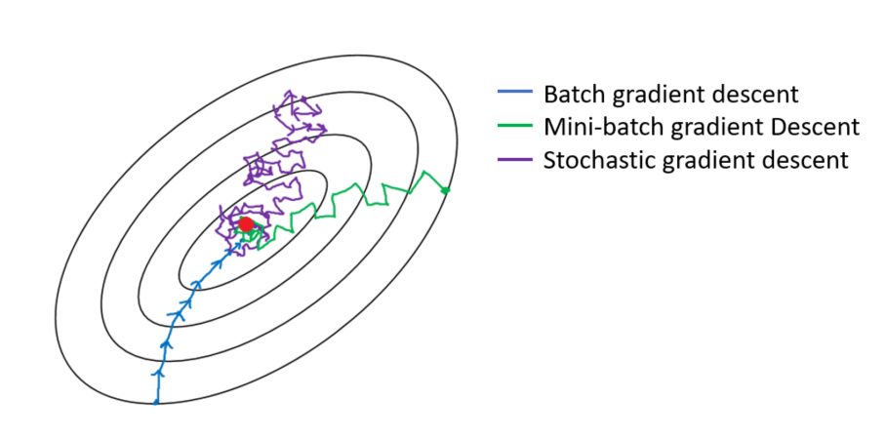
Stochastic Gradient Descent
It shares most of the advantages and the disadvantages with mini-batch version. Below are the ones that are specific to SGD:
It adds even more noise to the learning process than mini-batch that helps improving generalization error. However, this would increase the run time.
We can’t utilize vectorization over 1 example and becomes very slow. Also, the variance becomes large since we only use 1 example for each learning step.
Below is a graph that shows the gradient descent’s variants and their direction towards the minimum:
As the figure above shows, SGD direction is very noisy compared to mini-batch.

Slide 33
Mini Batch Gradient Descent
Mini-batch Gradient Descent is the go-to method since it’s a combination of the concepts of SGD and Batch Gradient Descent.
It simply splits the training dataset into small batches and performs an update for each of these batches.
Therefore it creates a balance between the robustness of stochastic gradient descent and the efficiency of batch gradient descent.
Note that it is the go-to algorithm when you are training a neural network and it is the most common type of gradient descent within deep learning.

Slide 34
Mini Batch Gradient Descent
The batch size is something we can tune. It is usually chosen as power of 2 such as 32, 64, 128, 256, 512, etc. The reason behind it is because some hardware such as GPUs achieve better run time with common batch sizes such as power of 2.
Common mini-batch sizes range between 50 and 256, but like for any other machine learning techniques, there is no clear rule, because they can vary for different applications.
Mini-batch Gradient Descent sums up over lower number of examples based on the batch size. Therefore, learning happens on each mini-batch of b examples:

Slide 35
Mini Batch Gradient Descent
The main advantages:
Faster than Batch version because it goes through a lot less examples than Batch (all examples).
Randomly selecting examples will help avoid redundant examples or examples that are very similar that don’t contribute much to the learning.
With batch size < size of training set, it adds noise to the learning process that helps improving generalization error.
Even though with more examples the estimate would have lower standard error, the return is less than linear compared to the computational burden we incur.
The main disadvantages:
On each iteration, the learning step may go back and forth due to the noise. Therefore, it wanders around the minimum region but never converges.
Due to the noise, the learning steps have more oscillations and requires adding learning-decay to decrease the learning rate as we become closer to the minimum.

Slide 36
Source
https://medium.com/paperspace/intro-to-optimization-in-deep-learning-momentum-rmsprop-and-adam-8335f15fdee2
https://towardsdatascience.com/gradient-descent-algorithm-and-its-variants-10f652806a3
https://towardsdatascience.com/stochastic-gradient-descent-with-momentum-a84097641a5d
https://towardsdatascience.com/gradient-descent-in-a-nutshell-eaf8c18212f0
https://towardsdatascience.com/difference-between-batch-gradient-descent-and-stochastic-gradient-descent-1187f1291aa1
https://towardsdatascience.com/types-of-optimization-algorithms-used-in-neural-networks-and-ways-to-optimize-gradient-95ae5d39529f
https://medium.com/search?q=gradient%20descent

